Slide 1
Data Types in C

Slide 2
Reserved words
Reserved by the C language.
Their meaning is already defined, and they cannot be re-defined to mean anything else.
Auto else long switch break
enum register typedef case extern
return union char float short
unsigned const for signe d void
continue goto sizeof volatile default
if static while do int
struct _Packed double

Slide 3
Data Types
The concept ‘data types‘ in C used to define a variable before its use.
Declaring the data type of a variable before use is must.
The value of a variable can be changed any time.
When the compiler encounters a declaration for a variable, it sets up a memory location for it.

Slide 4
Data Types
Primary data types: Fundamental data types in C namely integer(int), floating point(float), character(char) and void.
Derived data types: Derived data types are nothing but primary datatypes but a little twisted or grouped together like array, stucture, union and pointer.

Slide 5
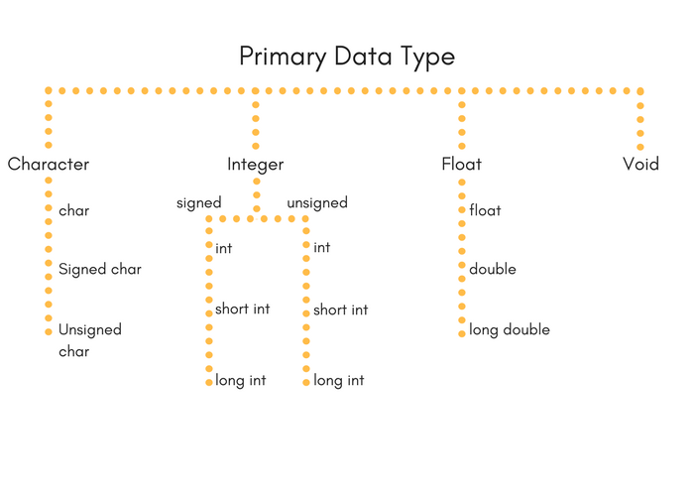
Data Types

Slide 6
Data Types
Integer Types:
Type | Storage size | Value range
char | 1 byte | -128 to 127 or 0 to 255
unsigned char | 1 byte | 0 to 255
signed char | 1 byte | -128 to 127
int | 2 or 4 bytes | -32,768 to 32,767 or -2,147,483,648 to 2,147,483,647
unsigned int | 2 or 4 bytes | 0 to 65,535 or 0 to 4,294,967,295
short | 2 bytes | -32,768 to 32,767
unsigned short | 2 bytes | 0 to 65,535
long | 4 bytes | -2,147,483,648 to 2,147,483,647
unsigned long | 4 bytes | 0 to 4,294,967,295

Slide 7
Data Types
Integer Types:
#include <stdio.h>
#include <limits.h>
int main() {
printf("Storage size for int : %d \n", sizeof(int));
return 0;
}

Slide 8
Data Types
Floating-Point Types:
Type | Storage size | Value range | Precision
float | 4 byte | 1.2E-38 to 3.4E+38 | 6 decimal places
double | 8 byte | 2.3E-308 to 1.7E+308 | 15 decimal places
long double | 10 byte | 3.4E-4932 to 1.1E+4932 | 19 decimal places

Slide 9
Data Types
Float Types:
#include <stdio.h>
#include <float.h>
int main() {
printf("Storage size for float : %d \n", sizeof(float));
printf("Minimum float positive value: %E\n", FLT_MIN );
printf("Maximum float positive value: %E\n", FLT_MAX );
printf("Precision value: %d\n", FLT_DIG ); return 0;
}

Slide 10
built-in data types
void - data type
The void data type is usually used with function to specify its type.
When we declare a function type as void it does not return any value.
void sum(){
----
}

Slide 11
Data Types
Void Type:
Sr.No. | Types & Description
1 | Function returns as void Functions in C which do not return any value i.e. return void. A function with no return value has the return type as void. For example, void exit (int status);
2 | Function arguments as void Functions in C which do not accept any parameter. That is, can accept a void. For example, int rand(void);
3 | Pointers to void A pointer of type void * represents the address of an object, but not its type. For example, a memory allocation function void *malloc( size_t size ); returns a pointer to void which can be casted to any data type.

Slide 12
Declaration
{
int i, j, k;
char c, ch;
float f, salary;
double d;
int Count;
Count = 5;
}

Slide 13
Declaration
{
char Letter;
Letter = 'x';
}
char ch = ‘a’;
main()
{
printf("sizeof(char) == %d\n", sizeof(char));
return 0;
}

Slide 14
Data Types
main() {
printf("sizeof(char) == %d\n", sizeof(char)); printf("sizeof(short) == %d\n", sizeof(short)); printf("sizeof(int) == %d\n", sizeof(int));
printf("sizeof(long) == %d\n", sizeof(long)); printf("sizeof(float) == %d\n", sizeof(float)); printf("sizeof(double) == %d\n", sizeof(double)); printf("sizeof(long double) == %d\n", sizeof(long double));
printf("sizeof(long long) == %d\n", sizeof(long long));
return 0;
}

Slide 15
Derived Data Types
Array – a finite sequence of variables of the same basic data type.
To create an array of 10 integers with the declaration.
int x[10];
Arrays occupy consecutive memory slots in the computer's memory.
x[0], x[1], x[2], ..., x[9]

Slide 16
Derived Data Types
String – an array of character variables
Structure – a collection of related variables of the same and/or different data types. The structure is called a record and the variables in the record are called members or fields

Slide 17
built-in datatypes
Pointer data Type
int *, float *, char * – used to denote a pointer type, which is a memory address type

Slide 18
Qualifiers
A type qualifier is used to refine the declaration of a variable, a function, and parameters, by specifying whether:
The value of a variable can be changed.
The value of a variable must always be read from memory rather than from a register
C language recognizes the following two qualifiers:
const
volatile

Slide 19
Qualifiers
The const qualifier is used to tell C that the variable value can not change after initialisation.
const float pi=3.14159;
pi cannot be changed at a later time within the program.
Another way to define constants is with the #define preprocessor which has the advantage that it does not use any storage.

Slide 20
Qualifiers
#include <stdio.h>
int main() {
const int LENGTH = 10;
const int WIDTH = 5;
const char NEWLINE = '\n';
int area;
area = LENGTH * WIDTH;
printf("value of area : %d", area);
printf("%c", NEWLINE);
return 0;
}

Slide 21
Qualifiers
#define LENGTH 10
#define WIDTH 5
#define NEWLINE '\n'
int main() {
int area;
area = LENGTH * WIDTH;
printf("value of area : %d", area);
printf("%c", NEWLINE);
return 0;
}

Slide 22
Qualifiers
The volatile qualifier declares a data type that can have its value changed in ways outside the control or detection of the.

Slide 23
Storage Class
A storage class defines the scope (visibility) and life-time of variables or functions within a C Program.
They precede the type that they modify.
There are four different storage classes in a C program −
auto
register
static
extern

Slide 24
Storage Class
auto Storage Class: auto storage class is the default storage class for all local variables.
{
int x;
auto int x;
}

Slide 25
Storage Class
Register Storage Class: Register storage class is used to define local variables that should be stored in a register instead of RAM.
Such variable has a maximum size equal to the register size (usually one word).
Variables that require quick access such as counters.
{
register int counter;
}

Slide 26
Storage Class
Static Storage Class: It instructs the compiler to keep a local variable in existence during the life-time of the program instead of creating and destroying it each time it comes into and goes out of scope.
In C programming, when static is used on a global variable, it causes only one copy of that member to be shared by all the objects of its class.

Slide 27
Storage Class
#include <stdio.h>
void func(void);
static int count = 5; /* global variable */
main() {
while(count--) {
func();
}
return 0;
}
/* function definition */
void func( void ) {
static int i = 5; /* local static variable */
i++;
printf("i is %d and count is %d\n", i, count);
}

Slide 28
Storage Class
Extern Storage Class: extern modifier is most commonly used when there are two or more files sharing the same global variables or functions.
#include <stdio.h>
int count ;
extern void write_extern();
main() {
count = 5;
write_extern();
}
#include <stdio.h>
extern int count;
void write_extern(void) {
printf("count is %d\n", count);
}

